Slide 1
GluonCV: Object Detection
Tong He
Applied Scientist, Amazon Web Services.
2018.12.17

Slide 2
Introduction

Slide 3
What is detection?
Classify and Localize the object

Slide 4
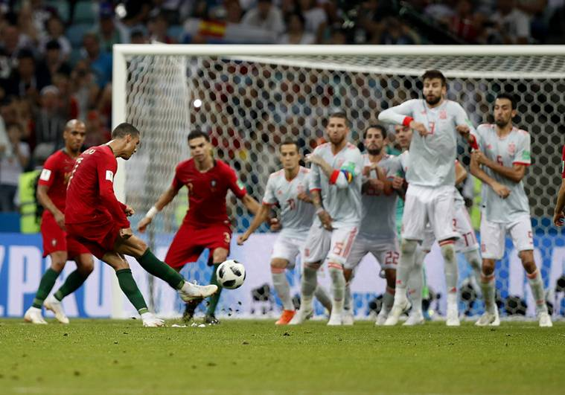
Why Object Detection?
Multiple Objects

Slide 5
Object Detection with Deep Learning

Slide 6
Object Detection with Deep Learning
Compared with Image Classification
Classification:
Input: image
Output: class label
Evaluation: accuracy
Detection:
Input: image
Output: boxes with labels
Evaluation: IoU

Slide 7
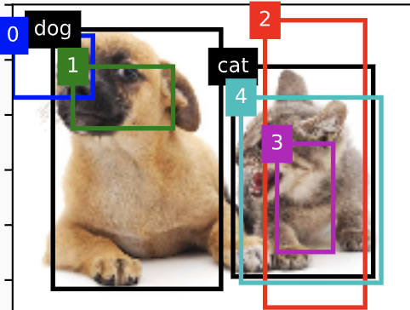
Object Detection with Deep Learning
Bounding Box
Generated by model
Represented by (h, w, x, y)

Slide 8
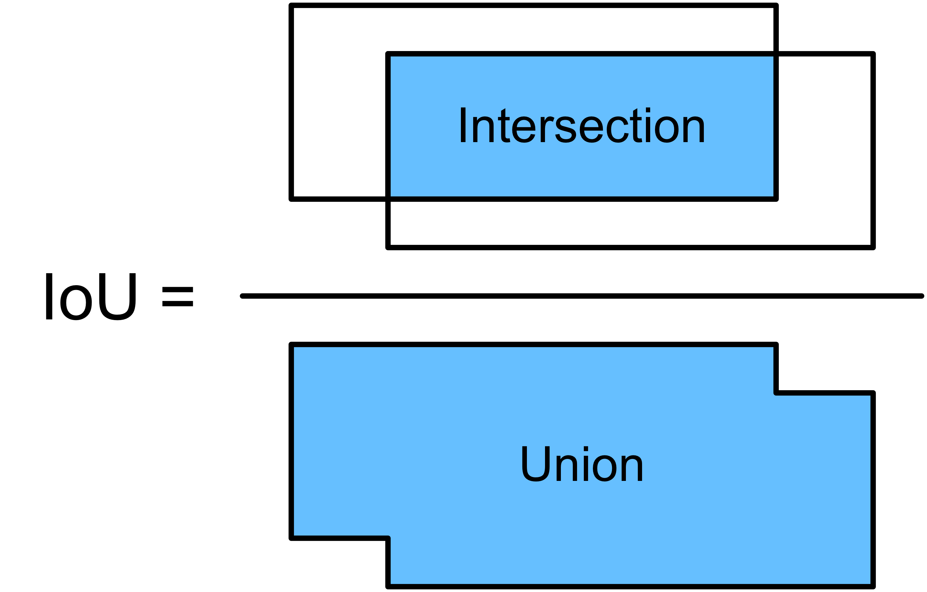
Object Detection with Deep Learning
IoU: Intersection over Union

Slide 9
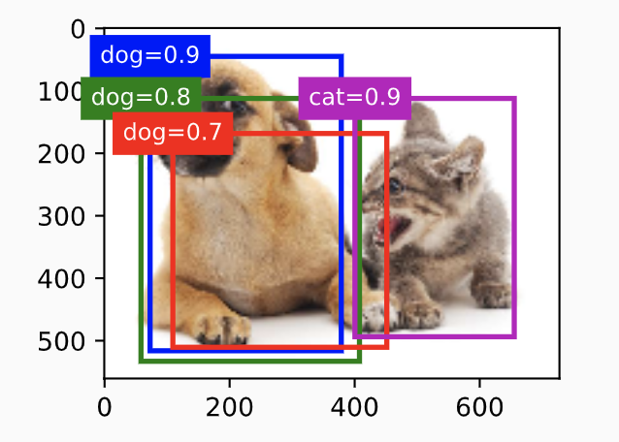
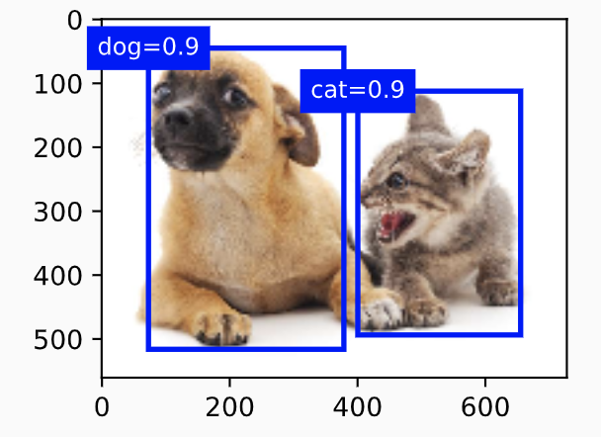
Object Detection with Deep Learning
NMS: Non-Maximum Suppression
Choose the highest score
Remove IoU > threshold
Repeat

Slide 10
Object Detection with Deep Learning
Three popular models
SSD
Faster R-CNN
YOLO

Slide 11
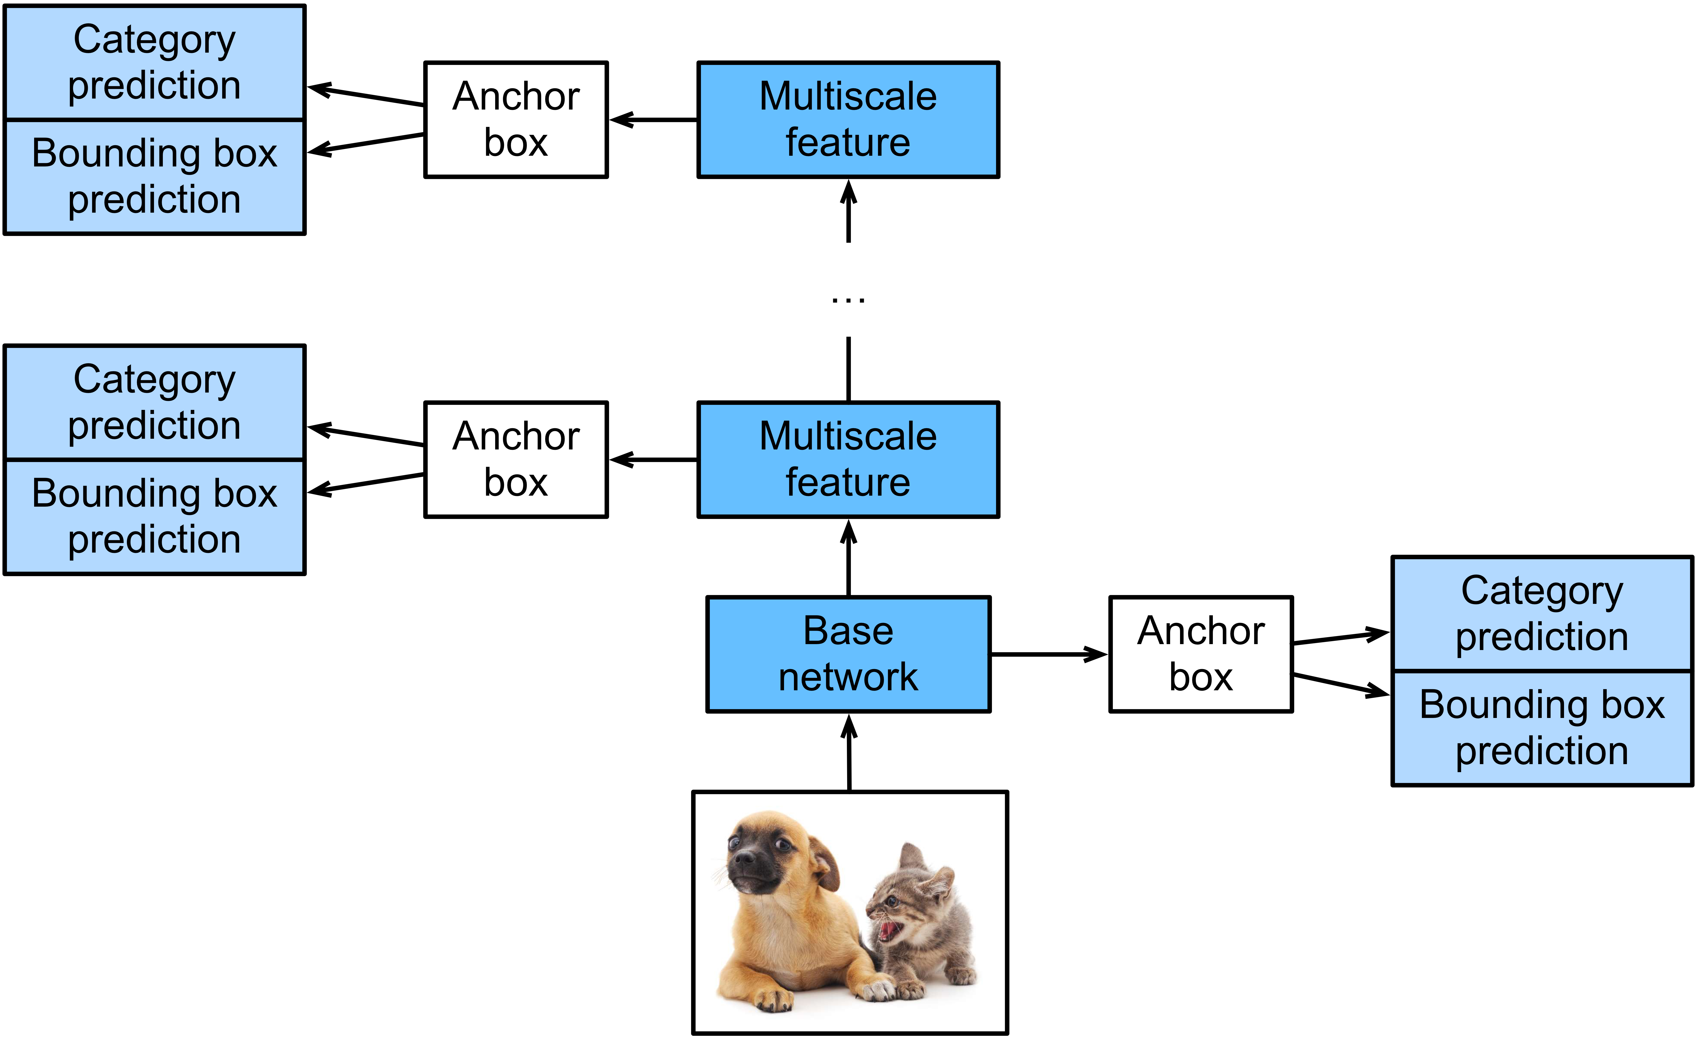
Object Detection with Deep Learning
SSD: Single Shot multibox Detection

Slide 12
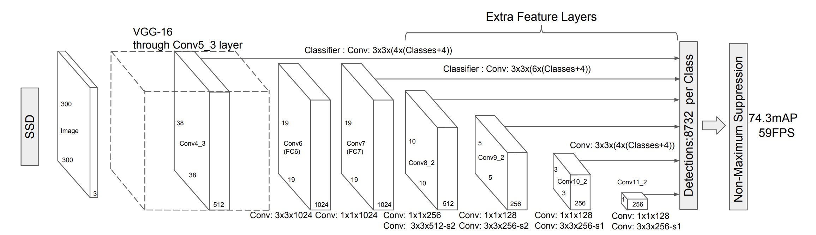
Object Detection with Deep Learning
SSD: Single Shot multibox Detection

Slide 13
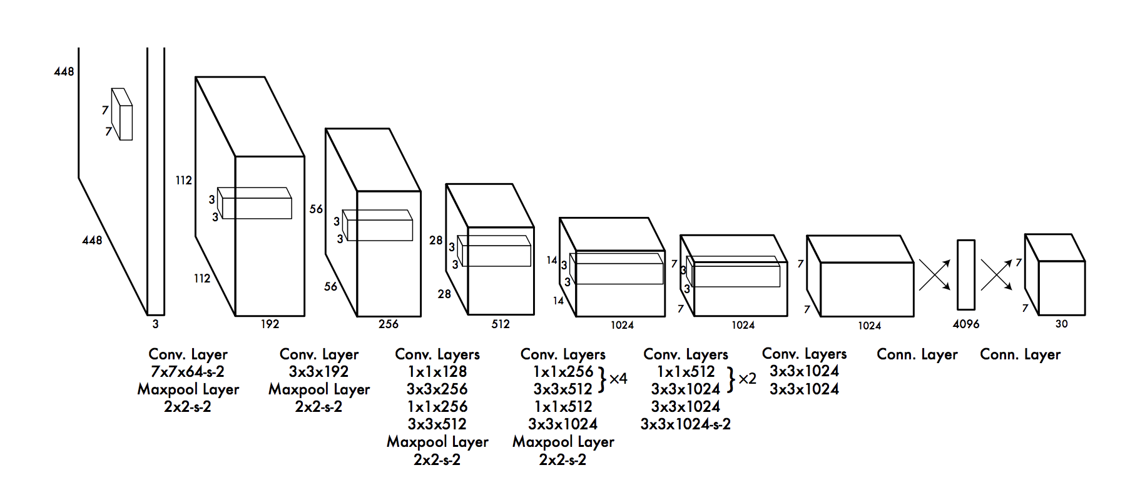
Object Detection with Deep Learning
YOLO: You Only Look Once

Slide 14
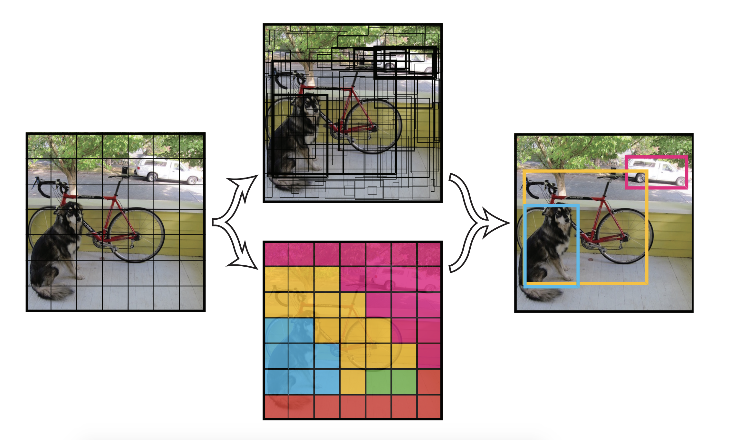
Object Detection with Deep Learning
YOLO: You Only Look Once

Slide 15
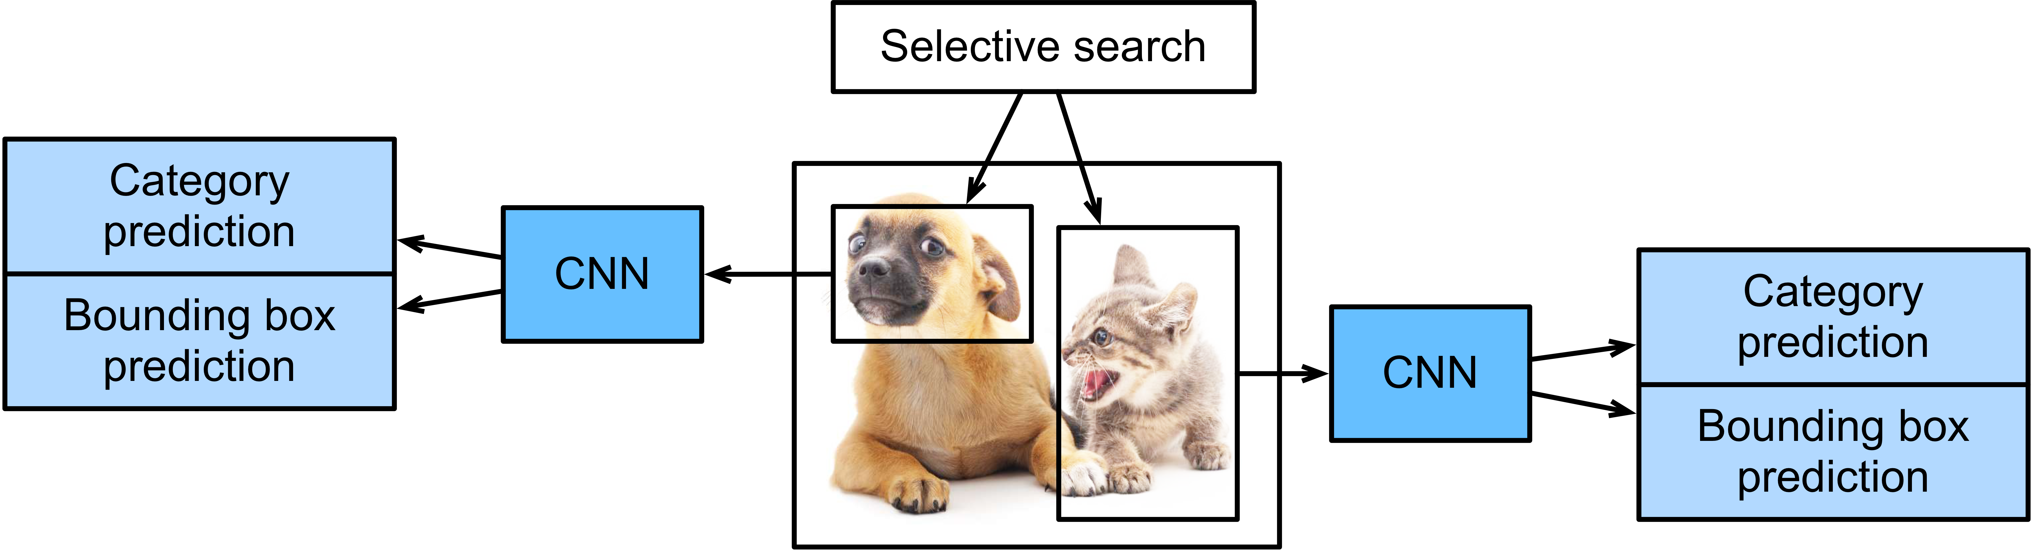
Object Detection with Deep Learning
R-CNN
Selective search is slow
Class prediction by SVM

Slide 16
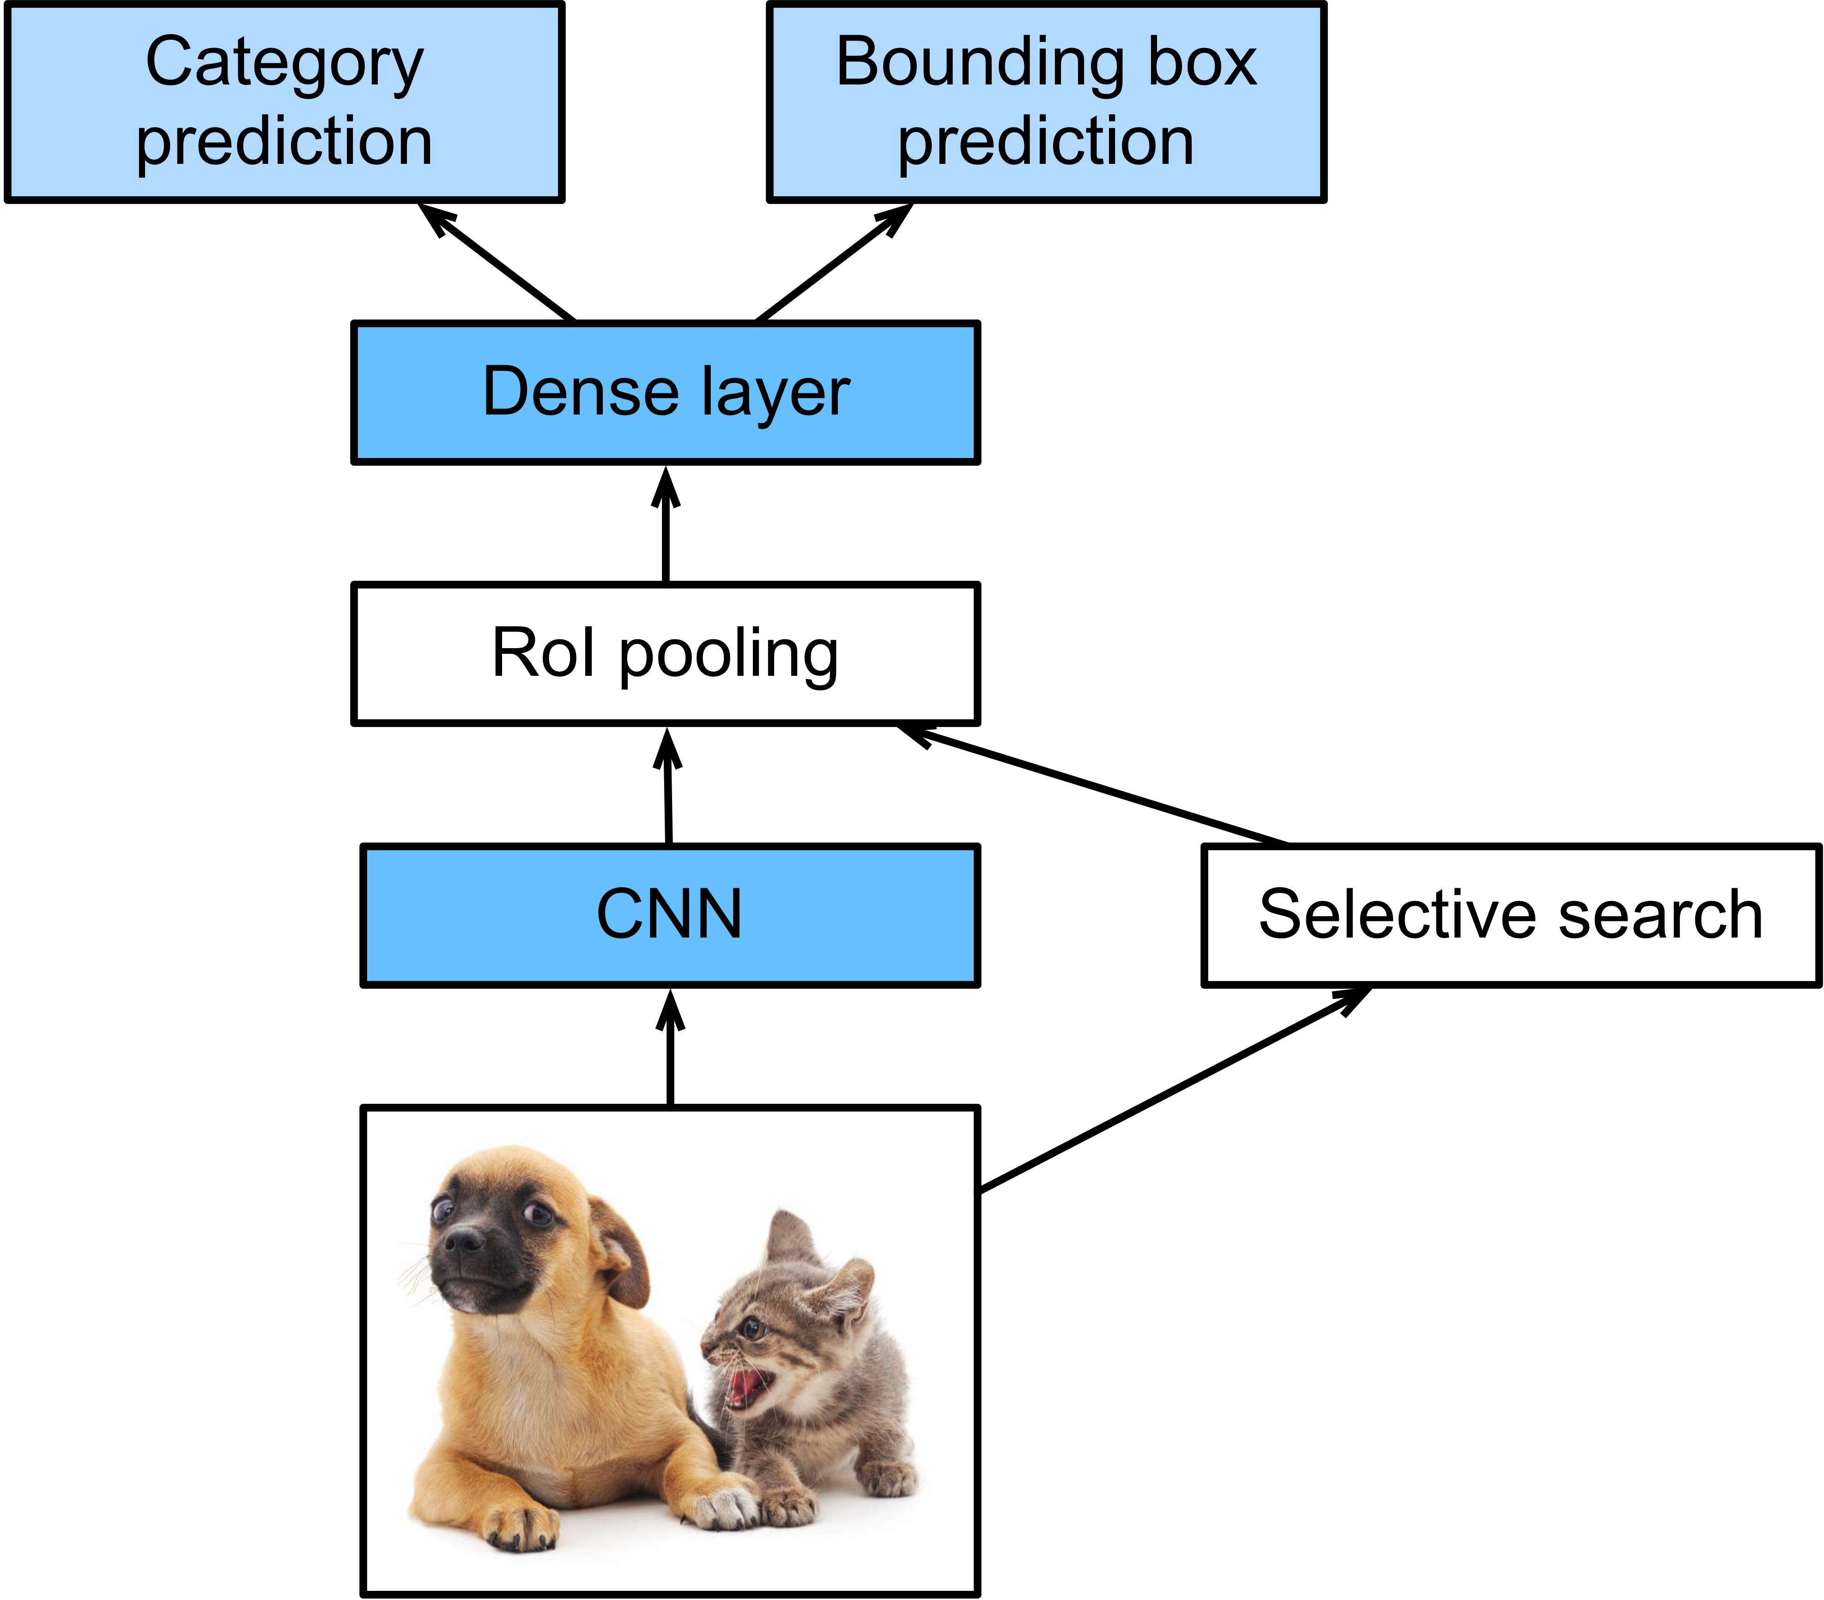
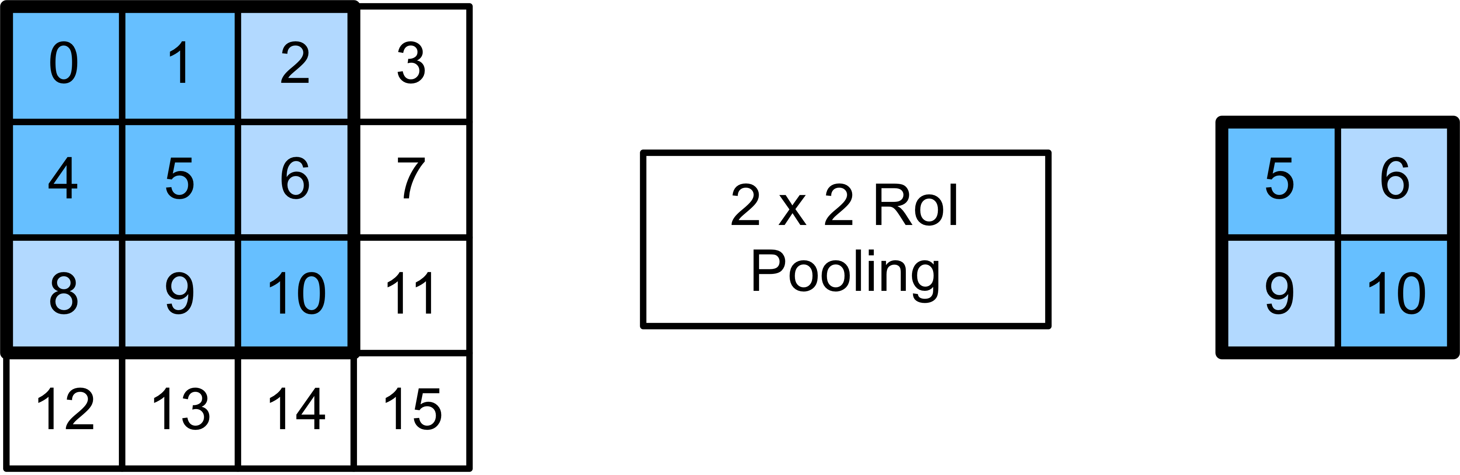
Object Detection with Deep Learning
Fast R-CNN
RoI Pooling
Prediction in dense layer

Slide 17
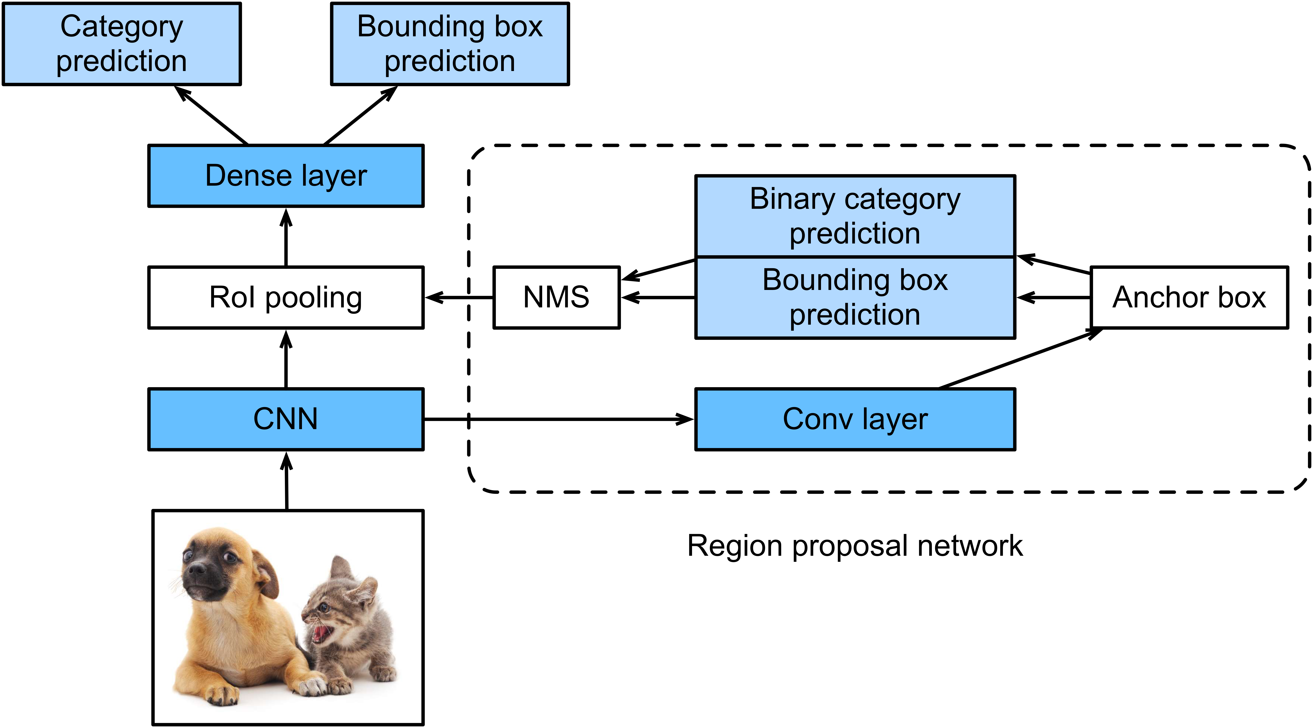
Object Detection with Deep Learning
Faster R-CNN
Replace selective search by region proposal network

Slide 18
Object Detection with Deep Learning
Summary
SSD
Fast, easy to implement, less accurate
Faster R-CNN
Slow, very accurate
YOLO
Fast, accurate

Slide 19
Object Detection with GluonCV

Slide 20
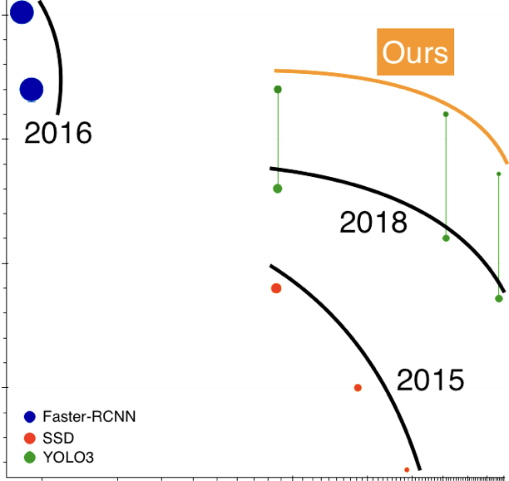
Object Detection with GluonCV
Model Zoo

Slide 21
Object Detection with GluonCV
Advanced Training
Learning rate schedule
Mix-up
Label smoothing

Slide 22
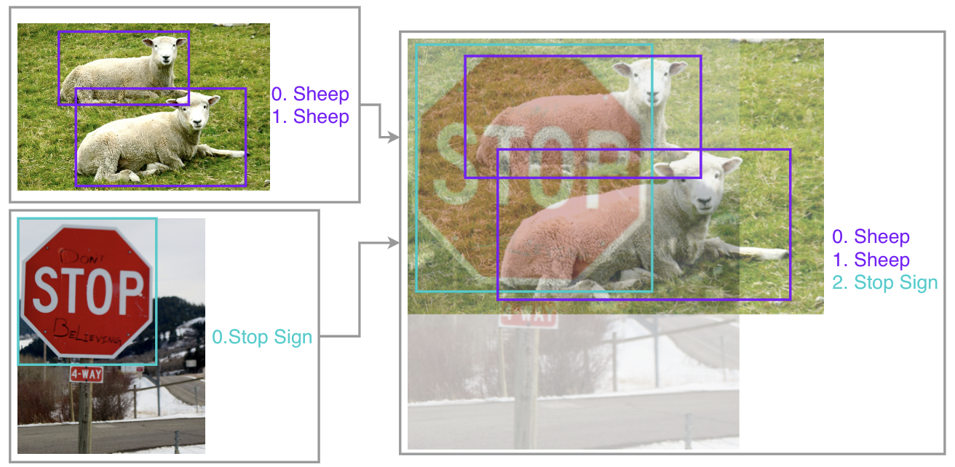
Object Detection with GluonCV
Mix-Up

Slide 23
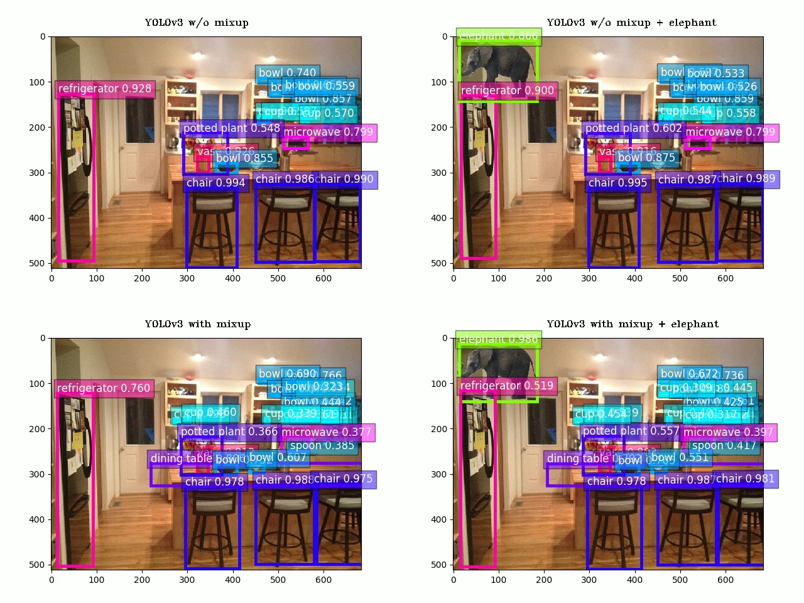
Object Detection with GluonCV
Elephant-in-the-Room

Slide 24
Object Detection with GluonCV
Resources:
Model Zoo: https://gluon-cv.mxnet.io/model_zoo/detection.html
Tutorials: https://gluon-cv.mxnet.io/build/examples_detection/index.html
Deep Learning Book: http://en.diveintodeeplearning.org/

Slide 25
Object Detection with GluonCV
Hands On!

